Slide 1

How we work with Claude.
A field guide for the Millennium Tours team.
What Claude is, how to use it every day, and where to aim it first.
PREPARED BY ALI MAMUJEE
01 / 23

Slide 2
Agenda.
Quick Intros
- Why Claude
- Basic Training & Awareness
- What has been built out - Explore what is next
Goal: Use Claude everyday, see the power in it, and improve the business.
ALLENIX · MILLENNIUM TOURS

Slide 3
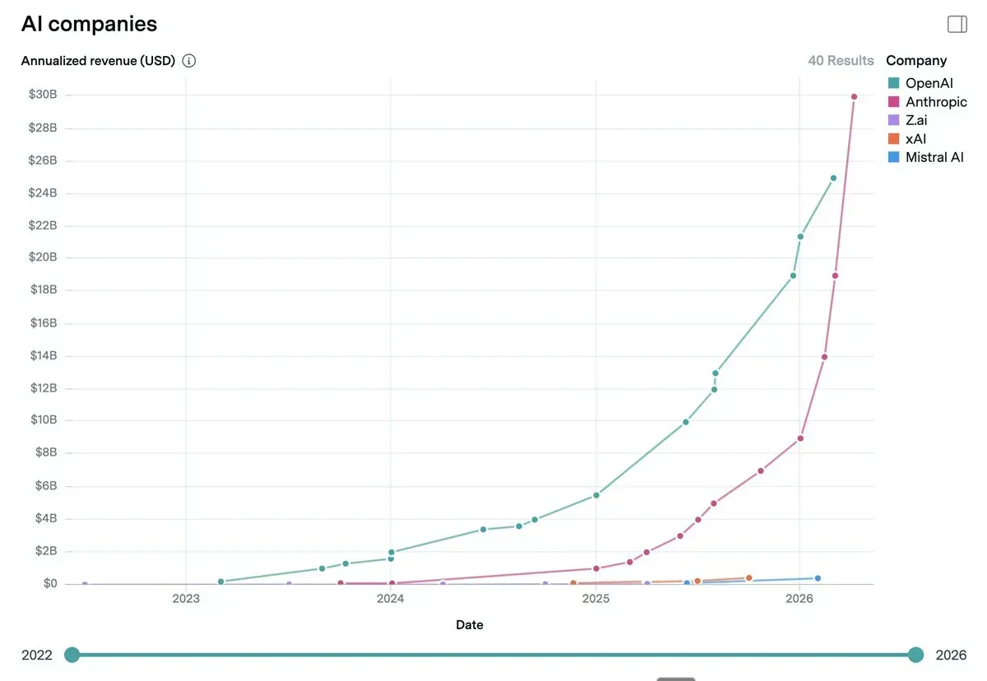
Anthropic is the fastest-growing company in history.
What’s driving it:
- An AI that writes code for you
- A digital coworker for any job
- Plugs into tools you already use
ALLENIX · MILLENNIUM TOURS
02 / 23

Slide 4
Millennium Tours summarized feedback from the team.
AREA
WHAT IT MEANS FOR MILLENNIUM TOURS
01
Document consistency
Master templates so proposals, invoices, T&Cs, and itineraries look identical regardless of who built them.
02
Faster client emails
Draft-ready group quotes, follow-ups, and replies in seconds instead of written from scratch each time.
03
Passenger data accuracy
Automated verification of names, passports, and dietary info before tickets are issued to cut manual errors.
04
Cleaner invoicing
Standard land and air invoice formats with inclusions, exclusions, and payment schedules spelled out every time.
05
Contract discipline
Consistent client T&Cs plus active tracking of airline contract deadlines so nothing expensive slips through.
06
Workflow automation
Standardized intake for new university requests and automated payment notifications tied to the accounting database.
ALLENIX · MILLENNIUM TOURS
06 / 23

Slide 5
You get one AI tool. We chose Claude on purpose.
Claude is built for work that has to be right the first time.
Client emails. Contracts. Passenger data. Invoices.
ACCURACY
TONE
SECURITY
Lowest hallucination rate of any major model.
Writes like a professional. Not a chatbot.
Your data is not used to train the model.
Enterprise plans include SSO, audit logs, and zero-retention. Passenger PII, payment details, and airline contracts stay in your tenant.
Claude is engineered to say "I don't know" instead of guessing. For a business built on itineraries and contracts, that matters more than speed.
Independent evaluations consistently rank Claude first on written English. No emoji spam. No "Certainly! Here is." Client-ready on the first pass.
ALLENIX · MILLENNIUM TOURS
03 / 23

Slide 6
Three surfaces. Know which one you are in.
Ping Pong
Action
Build
Chat
Cowork
Code
You ask. Claude answers. Everything stays in the chat window.
Claude works inside your real OneDrive folders. It creates files, not just text.
After you've mastered Cowork, Code is where you build custom tools for the agency.
FOR MILLENNIUM
FOR MILLENNIUM
FOR MILLENNIUM · LATER
Client emails in Outlook
Itineraries from scratch
Airline hold requests
Processing invoice folders
Building Word reports
Organising trip documents
A custom Trip Tracker app
One-click client report builders
Automations only Millennium needs
ALLENIX · MILLENNIUM TOURS
04 / 23

Slide 7
Four features worth knowing. Ignore the rest for now.
PROJECTS
SKILLS
A workspace that remembers you.
Instructions Claude remembers forever.
Upload your templates, voice guide, and airline contracts once. Every chat starts already knowing Millennium.
Write the rule once. "Always use Millennium invoice format." Claude follows it every time.
USE FOR: ALL WORK TASKS
LIKE TRAINING A NEW HIRE
CONNECTORS
PLUGINS
The pipe to Microsoft 365.
Bundles of skills and connectors.
Connect Outlook, OneDrive, SharePoint, and Teams. No more copy-pasting.
Pre-built kits for a job. Travel ops. Client email. Finance and invoicing.
MONTH 1 PRIORITY
MONTH 2 AND BEYOND
ALLENIX · MILLENNIUM TOURS
05 / 23

Slide 8
A structure for every prompt that matters.
A
Authority
Tell Claude who you need it to be. Be world class [Role].
G
Goal
State the outcome in one sentence. Your task is to [OUTCOME].
E
Evidence
Who it is for. Relevant background. Tone and voice.
N
Needs
Length. Structure (bullets, paragraphs, table). Any specific sections required.
T
Terms
Do’s and Dont’s. Do not proceed unless you are 95% confident. Ask one clarifying question if anything is unclear."
ALLENIX · MILLENNIUM TOURS
07 / 23

Slide 9
A Millennium Tours prompt, written the right way.
A · Authority. You are a world-class travel operations consultant at Millennium Tours, writing to a university procurement officer.
G · Goal. Your task is to draft a follow-up email that secures a signed contract for a 42-student Italy program by Friday.
E · Evidence. I copy /pasted the email below. The prospect is Dr. Lin at Trinity University. We quoted on March 14. She asked about insurance and cancellation terms in her last reply. Millennium voice is warm, precise, confident. Not casual, not corporate.
N · Needs. Three paragraphs. First paragraph warm recap. Second paragraph directly answers insurance + cancellation. Third paragraph offers a 15-minute call and names two time slots this week.
T · Terms. AVOID: em dashes, the word "journey," generic AI phrasing, promises we cannot keep. Do not proceed unless you are 95% confident. Ask one clarifying question if anything is unclear.
ALLENIX · MILLENNIUM TOURS
08 / 23

Slide 10
My Claude best practice maxims.
01
When in doubt, ask Claude.
02
Screenshots are your best friend.
The biggest barrier is not thinking to use it.
Claude reads images. Show it what you see.
03
Brief Claude like a smart new hire.
04
State the outcome before the steps.
Vague input gets vague output. Every time.
Tell Claude what you want, not how to do it.
05
Check the work.
06
Plan. Plan. Plan. Execute
First draft, not final answer. Claude is confident even when wrong.
Measure twice, cut once applies to AI
07
Share what you learn.
08
Claude is step one, not a side quest.
Five people learning together beat five learning alone.
Open it before Word, before email, before anything.
ALLENIX · MILLENNIUM TOURS
09 / 23

Slide 11
LIFT: 3–6 HOURS / PERSON / WEEK
Start here. Quick wins in Chat.
01
University follow-up emails
CHAT
Draft replies to procurement, academic advisors, and trip leads. Claude reads their last message and writes in Millennium voice.
02
First-pass itinerary drafts
CHAT
From a half-page brief, generate a day-by-day itinerary with inclusions, exclusions, and meal notes.
03
Vendor & airline hold requests
CHAT
Write precise, courteous hold requests. Includes deadlines, group sizes, and fare class specifics.
04
Traveller support replies
CHAT
Respond to common passenger questions. Baggage, visas, dietary, itinerary changes.
05
"What am I missing?" on a contract
CHAT
Paste an airline or vendor contract. Ask Claude to flag anything that could cost money later.
06
Voice & tone cleanup
CHAT
Paste a draft written by a junior. Claude rewrites in Millennium voice while keeping the content.
ALLENIX · MILLENNIUM TOURS
10 / 23

Slide 12
LIFT: WHOLE WORKFLOWS, NOT TASKS
Department workflows in Cowork.
07
Invoice reconciliation from a folder
COWORK
Point Claude at a OneDrive folder of airline and vendor invoices. It produces a reconciliation sheet and flags mismatches against your bookings.
08
Passenger manifest builder
COWORK
From vendor confirmations and intake forms, generate clean Word manifests per trip. Passport numbers, dietary, room pairings, verified.
09
Proposal factory
COWORK
Drop 12 intake forms in a folder. Get 12 branded Millennium proposals out. All identical in format, unique in content.
10
Airline contract deadline tracker
COWORK
Scan your contracts folder monthly. Output a Word memo listing every expiry, option deadline, and minimum-pax clause in the next 90 days.
11
Trip file bulk-rename & organise
COWORK
Apply the Millennium naming convention across a messy drive. Files grouped by trip, client, year.
12
Monthly brand sweep
COWORK
Cowork flags off-brand files in your outgoing doc folder. Wrong logo, footer, or T&Cs version.
ALLENIX · MILLENNIUM TOURS
11 / 23

Slide 13
REQUIRES ALLENIX BUILD SUPPORT
Built systems. Only if the ROI is obvious.
13
University intake portal
CODE
A simple branded form. Requests land, Claude drafts a first-pass proposal automatically, a human reviews and sends. Cuts intake-to-quote to under 24 hours.
14
Passenger data verifier
CODE
A small tool that checks passport names against tickets, dates against itineraries, and dietary info against manifests. Runs before every ticketing deadline.
15
Payment-notification agent
CODE
Connected to your accounting database. When a payment is due, overdue, or received, the right email goes out automatically in Millennium voice.
16
Itinerary-to-invoice generator
CODE
One approved itinerary produces the client proposal, the land invoice, the air invoice, the T&Cs, and the passenger manifest template. In one pass.
17
"Magnolia" ops dashboard
CODE
The control panel for the three above. What is live, what is stuck, what needs a human. The internal system that runs under everything else.
ALLENIX · MILLENNIUM TOURS
12 / 23

Slide 14
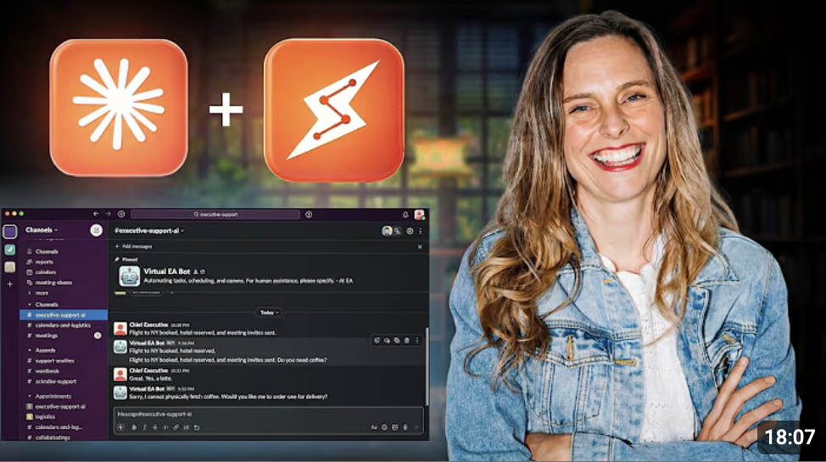
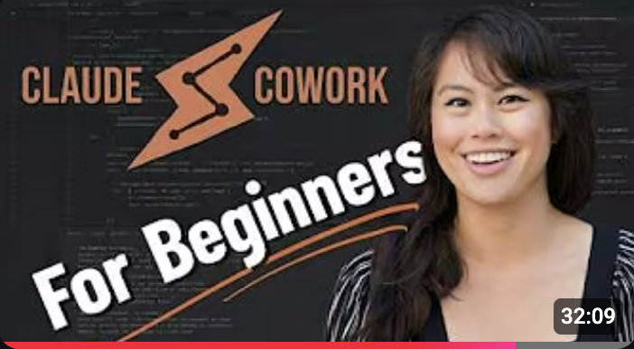
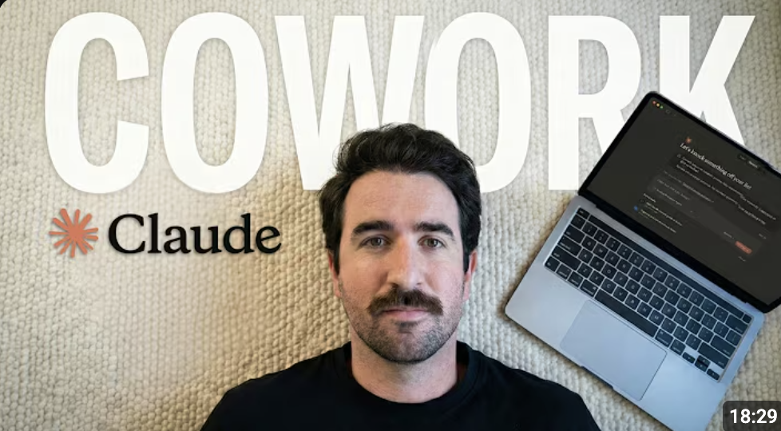
Subscribe to these 3 YouTube Channels.
Brooke Wright
Sabrina Ram0nov
Eliot Prince
CLAUDE FOR EVERYDAY WORK
PRODUCTIVITY & WORKFLOWS
AI AUTOMATION
The best starting point for non-technical professionals using Claude for real business tasks. Clear, practical, beginner-friendly.
Teaches how to build repeatable Claude workflows that save hours each week. Ideal for teams adopting AI for the first time.
Practical automation systems for business owners. Saving time and cutting costs with AI tools. No technical background needed.
https://www.youtube.com/watch?v=vRWeKtVHJg0&t=45s
https://www.youtube.com/watch?v=1dSNfnFL40c&t=9s
https://www.youtube.com/watch?v=ZeWfksNXlbU
ALLENIX · MILLENNIUM TOURS
13 / 23

Slide 15
Appendix
You can review this on your own time
14 / 23

Slide 16
Why not ChatGPT, Gemini, or Grok?
WHERE IT MATTERS
CLAUDE
CHATGPT
GEMINI
GROK
Business writing quality
Best in class
Good, generic
Corporate, stiff
Casual, off-brand
Client-ready email, proposal prose
Long-document handling
200K tokens
128K
1M (shallow)
128K
Contracts, itineraries, multi-file
Hallucination rate
Lowest
Medium
Medium
Highest
Lower = safer for client work
Works on your real files
Yes · Cowork
Partial
Google only
No
OneDrive, Outlook, SharePoint
Enterprise data privacy
Default on
Opt-in
Opt-in
Limited
Zero-retention, no training on your data
ALLENIX · MILLENNIUM TOURS
15 / 23

Slide 17
Chat is a thinking partner. Not a file system.
USE IT LIKE
YOU → A university group of 42 students needs a Rome–Florence–Venice itinerary, 7 days, moderate budget. Land-only. Draft a proposal in our Millennium voice. CLAUDE → Returns a formatted proposal with day-by-day inclusions, exclusions, inclusions table, and a paragraph on travel insurance. You edit the last 20%.
A senior colleague sitting next to you. You hand them a half-finished draft or a vague problem. They give you something you can use in sixty seconds.
Draft a follow-up email to a university procurement contact
Rewrite this itinerary in a friendlier voice
What am I missing in this airline contract?
Turn these five bullet points into a quote summary
ALLENIX · MILLENNIUM TOURS
16 / 23

Slide 18
Cowork is a colleague with hands. It touches real files.
USE IT LIKE
GROUND RULES
An ops assistant who can open a OneDrive folder, read every file inside, and produce a cleaned-up deliverable. Word docs. Excel sheets. Renamed files.
Three things to know.
Desktop app required. Cowork only works in the Mac / Windows Claude app, not the browser.
Read 40 airline invoices, output a reconciliation sheet
Take 12 intake forms, generate 12 branded proposals
Bulk-rename trip files to the Millennium convention
It asks permission. Before writing or overwriting anything, Claude confirms with you.
Start small. Point it at one folder, one task. Not your whole drive.
ALLENIX · MILLENNIUM TOURS
17 / 23

Slide 19
A Project is a folder with a brain.
A workspace where Claude remembers everything about one area of your job: files, instructions, and shared context across every chat inside it.
HOLDS FILES
CUSTOM INSTRUCTIONS
SHARED CONTEXT
Reference docs stay loaded.
Rules for this work.
New chats start informed.
"Always use our preferred Jordan vendors." "Voice is warm but precise." Claude follows them in every chat inside the project.
Vendor lists, templates, contact sheets, and contracts live inside the project. Always available, never re-uploaded.
Open a fresh conversation in the project — Claude already knows the background. No re-briefing every time.
At Millennium: create a "University Programs" project with the contact list, itinerary templates, and "use preferred vendors in Jordan" as instructions. Anyone opening a new chat in it already has the full picture.
ALLENIX · MILLENNIUM TOURS
18 / 23

Slide 20
A Skill is a recipe card.
A reusable instruction that produces the same kind of output, every time — invoice, follow-up email, manifest — regardless of which project you trigger it from.
REPEATABLE
PORTABLE
TASK-SPECIFIC
Same process. Same quality.
Works anywhere.
Does one thing well.
Inside any project. Outside any project. The skill goes wherever the work is — that's the point.
An invoice. An email. A manifest. A skill is narrow on purpose — that's what makes it dependable.
A defined recipe means the output looks the same whether it ran on Tuesday or six months from now.
At Millennium: build an "Invoice Generator" skill that takes a client name, trip details, and line items and returns a formatted Word doc. Trigger it from University Programs, Corporate Travel, or no project at all — same result.
ALLENIX · MILLENNIUM TOURS
19 / 23

Slide 21
Side by side. Two tools, two jobs.
PROJECT
SKILL
Think of it as
A folder with a brain
A recipe card
Purpose
Memory across one area of work
Instructions for one repeatable task
Scope
Broad — an entire function or department
Narrow — one specific output or process
Portability
Stays put. Context is the point.
Goes anywhere. Portability is the point.
Lifespan
Always on. Grows over time.
Triggered on demand. Stays the same.
ALLENIX · MILLENNIUM TOURS
20 / 23

Slide 22
Five functions. Five brains.
Each project has its own files, instructions, and owner.
Land Operations
Hotel contracts, ground transport, local guides.
Airline Operations
Fare rules, group bookings, airline contacts.
University Programs
University contacts, academic calendars, templates.
Corporate Travel
Energy company clients, policies, billing.
Finance & Admin
Invoicing, QuickBooks, internal operations.
ALLENIX · MILLENNIUM TOURS
21 / 23

Slide 23
Project, Skill, or just a chat?
New Project
New Skill
Just a chat
If Claude needs to remember something — files, rules, ongoing context — it's a project.
If Claude needs to do a task the same way every time, it's a skill.
If it's a one-off — a new trip, a single client, a quick question — start a chat inside an existing project.
"I need to generate an invoice."
"Claude needs to know our Jordan vendors."
→ SKILL
"Baylor Malaysia trip needs planning."
→ PROJECT
"Follow-up email after every client call."
→ CHAT IN UNIVERSITY PROGRAMS
→ SKILL
"Corporate clients need different rules from groups."
"What's the cheapest way to move 42 students?"
→ PROJECT
→ CHAT IN AIRLINE OPS
Rule of thumb: if Claude needs to remember, that's a project. If Claude needs to do, that's a skill. Everything else is just a chat.
ALLENIX · MILLENNIUM TOURS
22 / 23

Slide 24
Sonnet is your default. Always.
FASTEST, LIGHTEST
YOUR DEFAULT. ALWAYS.
MOST POWERFUL, USE SPARINGLY
Haiku
Sonnet 4.6
Opus 4.7
Quick lookups. Classification. Very high volume. Not enabled on your plan right now.
Save for genuinely complex work. Multi-document contract analysis. Long-form strategy. Financial modelling across many files.
Handles all Millennium daily work. Client emails. Itineraries. Vendor comms. Contract summaries. Proposal drafts. If you are unsure, use Sonnet.
SKIP FOR NOW
USE 95% OF THE TIME
COMPLEX CONTRACTS ONLY
ALLENIX · MILLENNIUM TOURS
23 / 23

